Slide 1
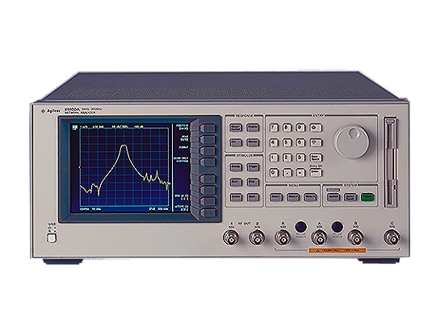
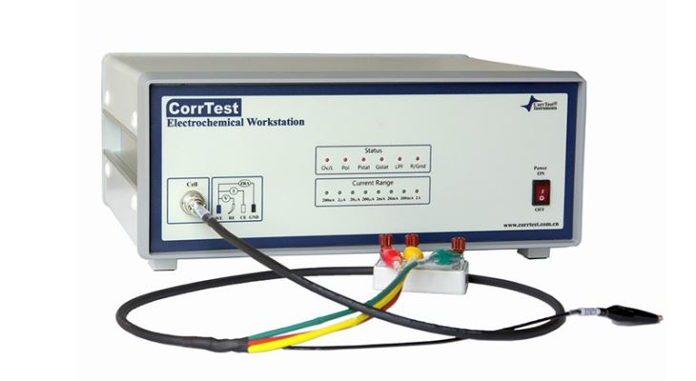
Motivations
The EIS workstation gives the impedance spectra of the sample over a range of low frequencies from 0.1Hz to 100kHz. It was thought that the information gained through studying this frequency range may not be enough.
The EIS usually takes 10s (10 points of measurement) to generate the impedance spectroscopy, we want to measure it in real-time. VNA might be a possible solution because each sweep only takes 50ms (200 points of measurement) for VNA
Agilent E5100A Vector network analyzer
Frequency range: 10Khz – 300Mhz
Sweep time: ~50ms
EIS workstation
Frequency range: 0.1hz – 100khz
Sweep time: ~10s
https://etd.ohiolink.edu/!etd.send_file?accession=ucin1367943908&disposition=inline
Notes:
The other task we are working with in the last few weeks is to investigate the possibility of measuring electrochemical impedance spectroscopy or monitoring the impedance at a single frequency in real time application by using a Vector Network analyzer, also VNA . There are two reasons why we would like to use VNA. The first reason is ………………….. As you can see here, the vector network analyzer in our lab generally works over the broader range of frequency from 10khz to 300 Mhz. You can check out the link here, in a study conducted by university of Cincinnati, the researcher report that the frequency range of EIS work station is not informative enough to distinguish a tumor in the tissues. The second reason is about the speed………… since we also want to monitor the impedance at a single frequency. ………….

Slide 2
Two fundamental questions here
How does the VNA measure the impedance? Can it be extended to an electrochemical system?
Since we would like to do it in real time, is there any way we can trigger the device and record the data by computer?

Slide 3
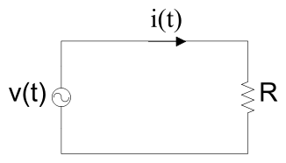
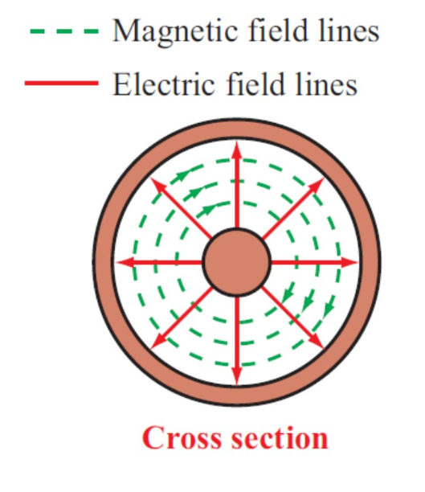
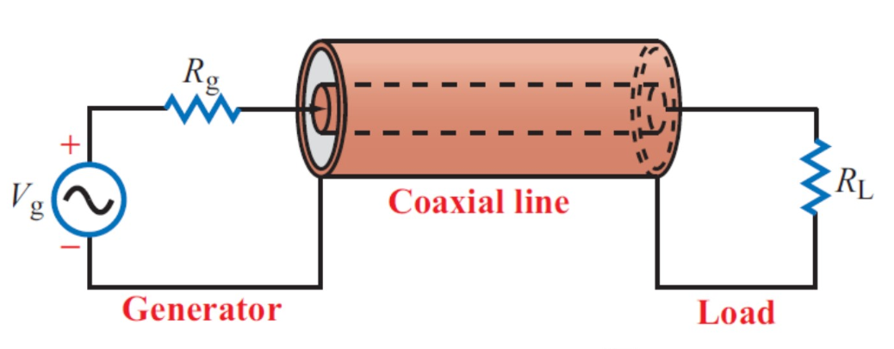
The mechanism of VNA
Terminated transmission line
Example Coaxial cable
https://www.sciencedirect.com/topics/engineering/transmission-line-theory
Notes:
The physical model behind this machine is what we call a terminated transmission line. This is different from a normal alternating circuit.

Slide 4
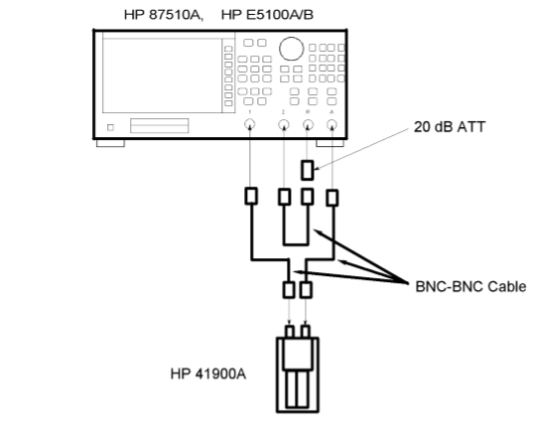
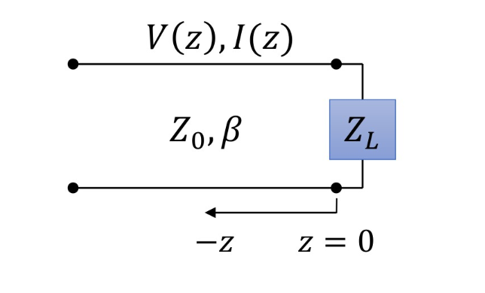
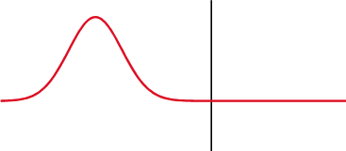
The mechanism of VNA
Terminated transmission line
Example Coaxial cable
https://www.sciencedirect.com/topics/engineering/transmission-line-theory
Notes:
For our devices, after connecting the network test fixature, we can convert the set up into a model shown on the right, V I are the voltage and current along the transmission line, Zo is the characteristic impedance of the transmission line, it indicates the relationship between the electrical wave and the magnetic wave. β is a propagation parameter, it determines the speed and wave length of the incoming wave. How the wave is propagated in this circuit is demonstrated here, as you can see, after the single pulse encountering the load, a portion of the incoming signal is transmitted, and for the reflected signal, its amplitude decreases and the phase changes.

Slide 5
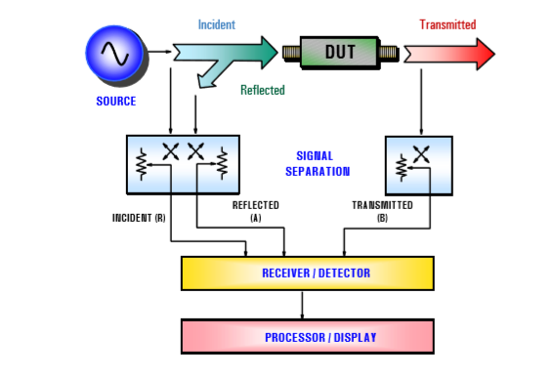
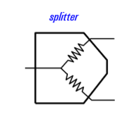
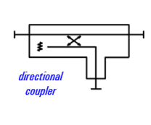
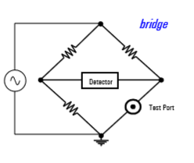
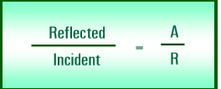
The mechanism of VNA
Signal separation
measure a portion of the incident wave to provide a reference.
separate the incident and reflected signal
Reflection coefficient/
Gain phase plot
https://www.keysight.com/upload/cmc_upload/All/BTB_Network_2005-1.pdf
Notes:
The animation in the last slide only show the activity of a single pulse, you can imaging that if we continuously send wave to the system, the incidence wave and reflected wave will finally mixed with each other. So it is important to separate them. The networks analyser has its building signal separation circuitry. Basically How it works is like, …………………., if you want to know more about the signal separation circuit, you could check the web below. After we get the signal, we can convert them to the phaser domain and divide them to get a complex number, we call it reflection coefficient, the reflection coefficient can be different at different frequency. If we put the coefficient at different frequency into a graph, we can get a Gain phase plot like this.

Slide 6
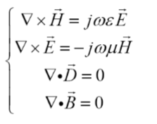
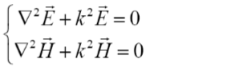
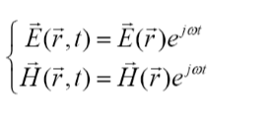
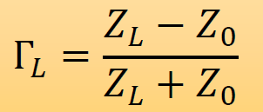
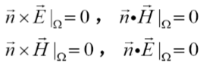
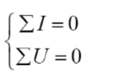
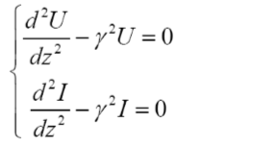
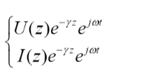
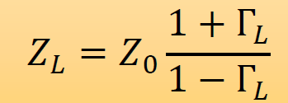
The mechanism of VNA
Relation between the reflection coefficient and load impedance
Maxwell’s equations
Wave equations and boundary conditions
Solution to EM wave propagation
Kirchhoff's laws
Wave equations and boundary conditions
Solution to voltage and current distribution
https://www.sciencedirect.com/topics/engineering/reflection-coefficient
Notes:
Then you might wonder that why do we need the gain phase plot and the reflection coefficient? The answer is, we can actually calculate the load impedance from the gain phase plot. To do that, we need to consider the Maxwell equations, the Kirchhoff’s law, the wave equations of the wave propagation and the apply the boundary condition at the load. There are a lot of mathematics induction behind the calculation and it could be quite difficult. But fortunately some smart people have solved those equations for us and give a very nice formula here. Which indicates that, the coefficient is equal to ……. And the load impedance is …..

Slide 7
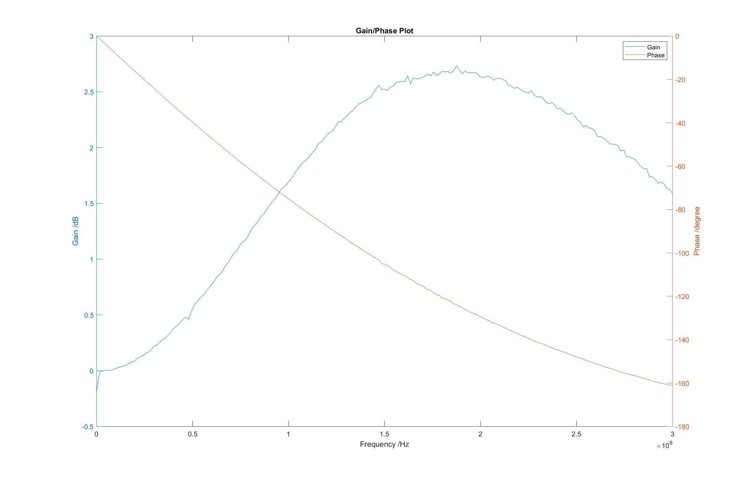
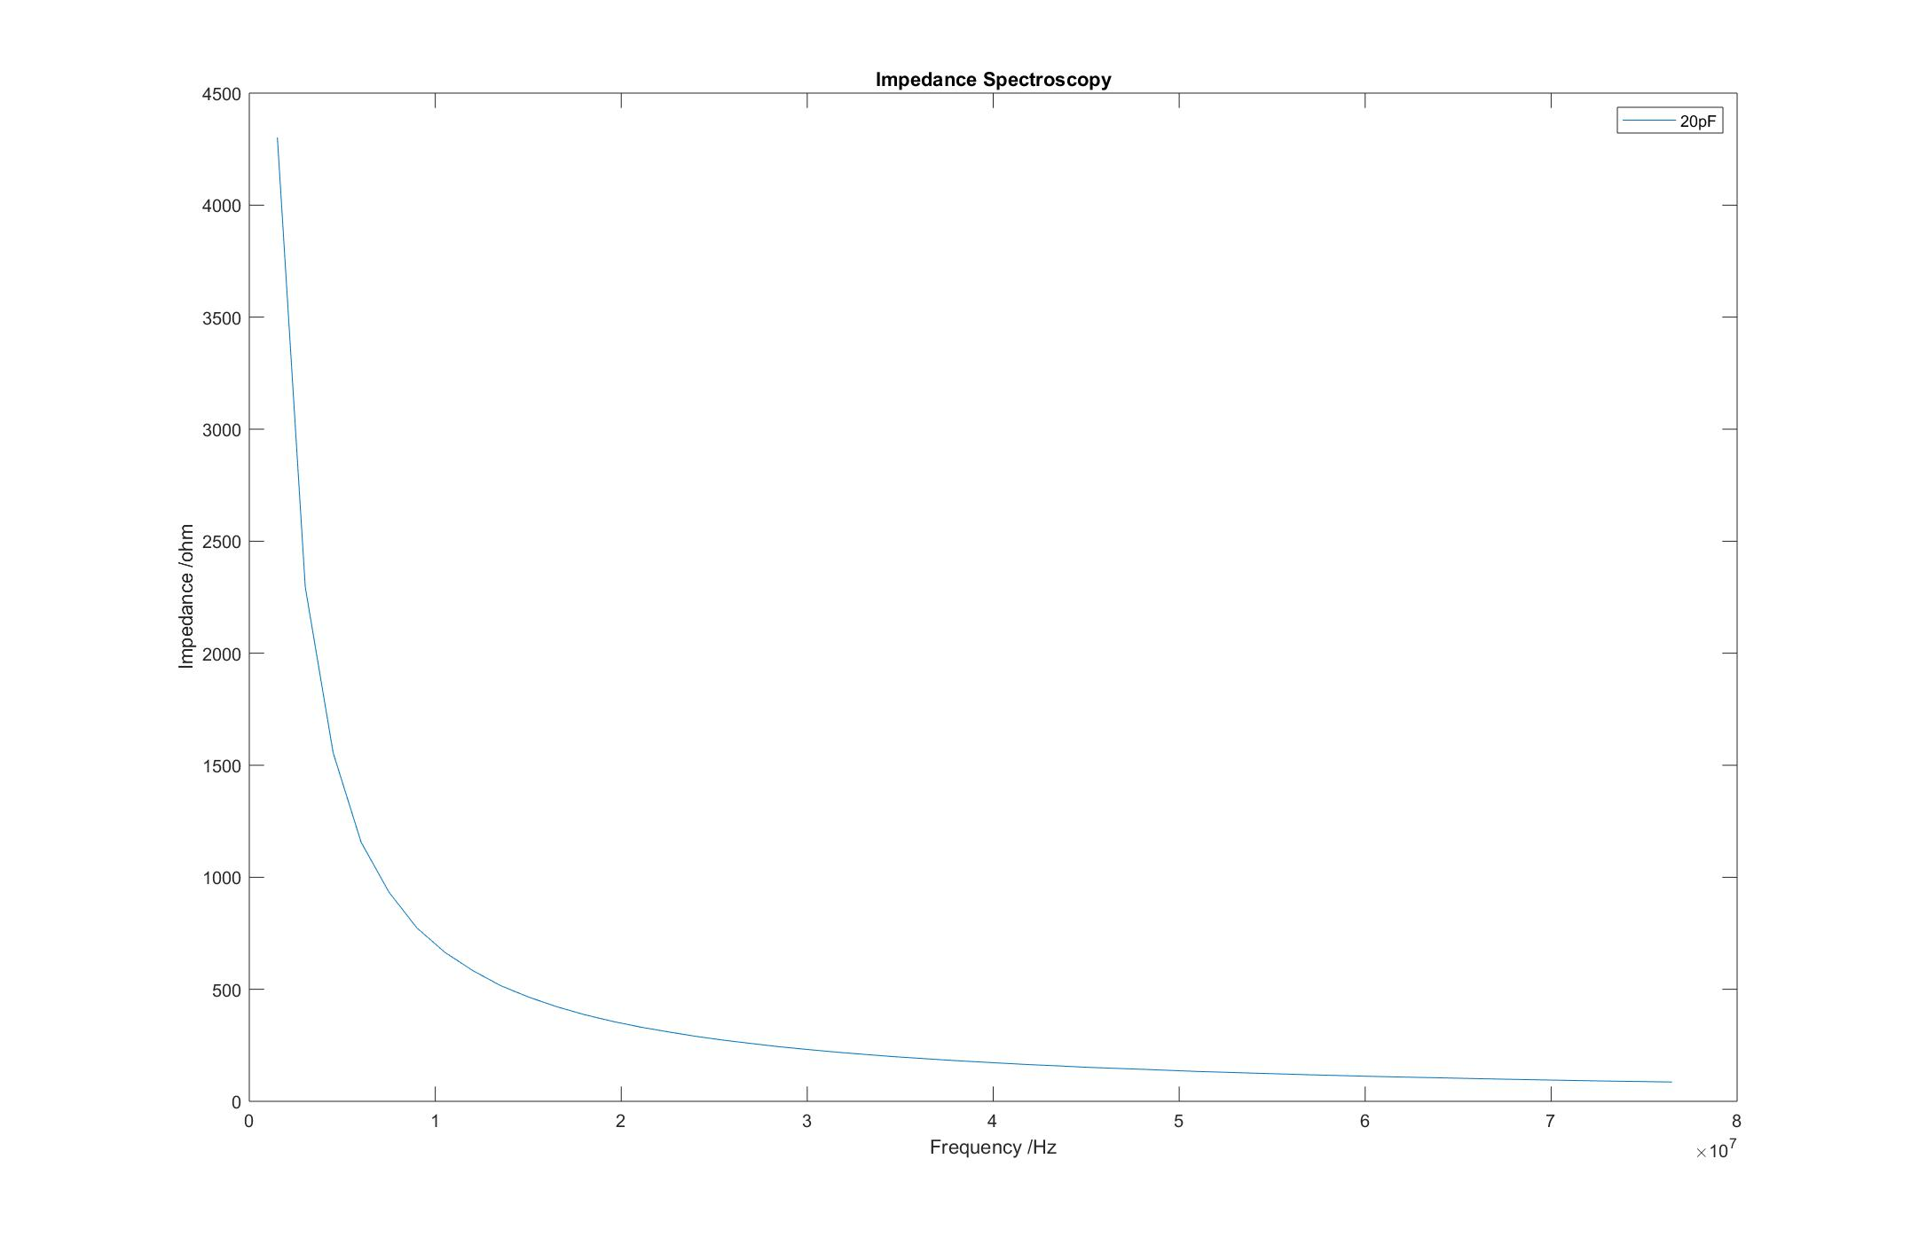
The mechanism of VNA
An example of 20pf capacitor

Slide 8
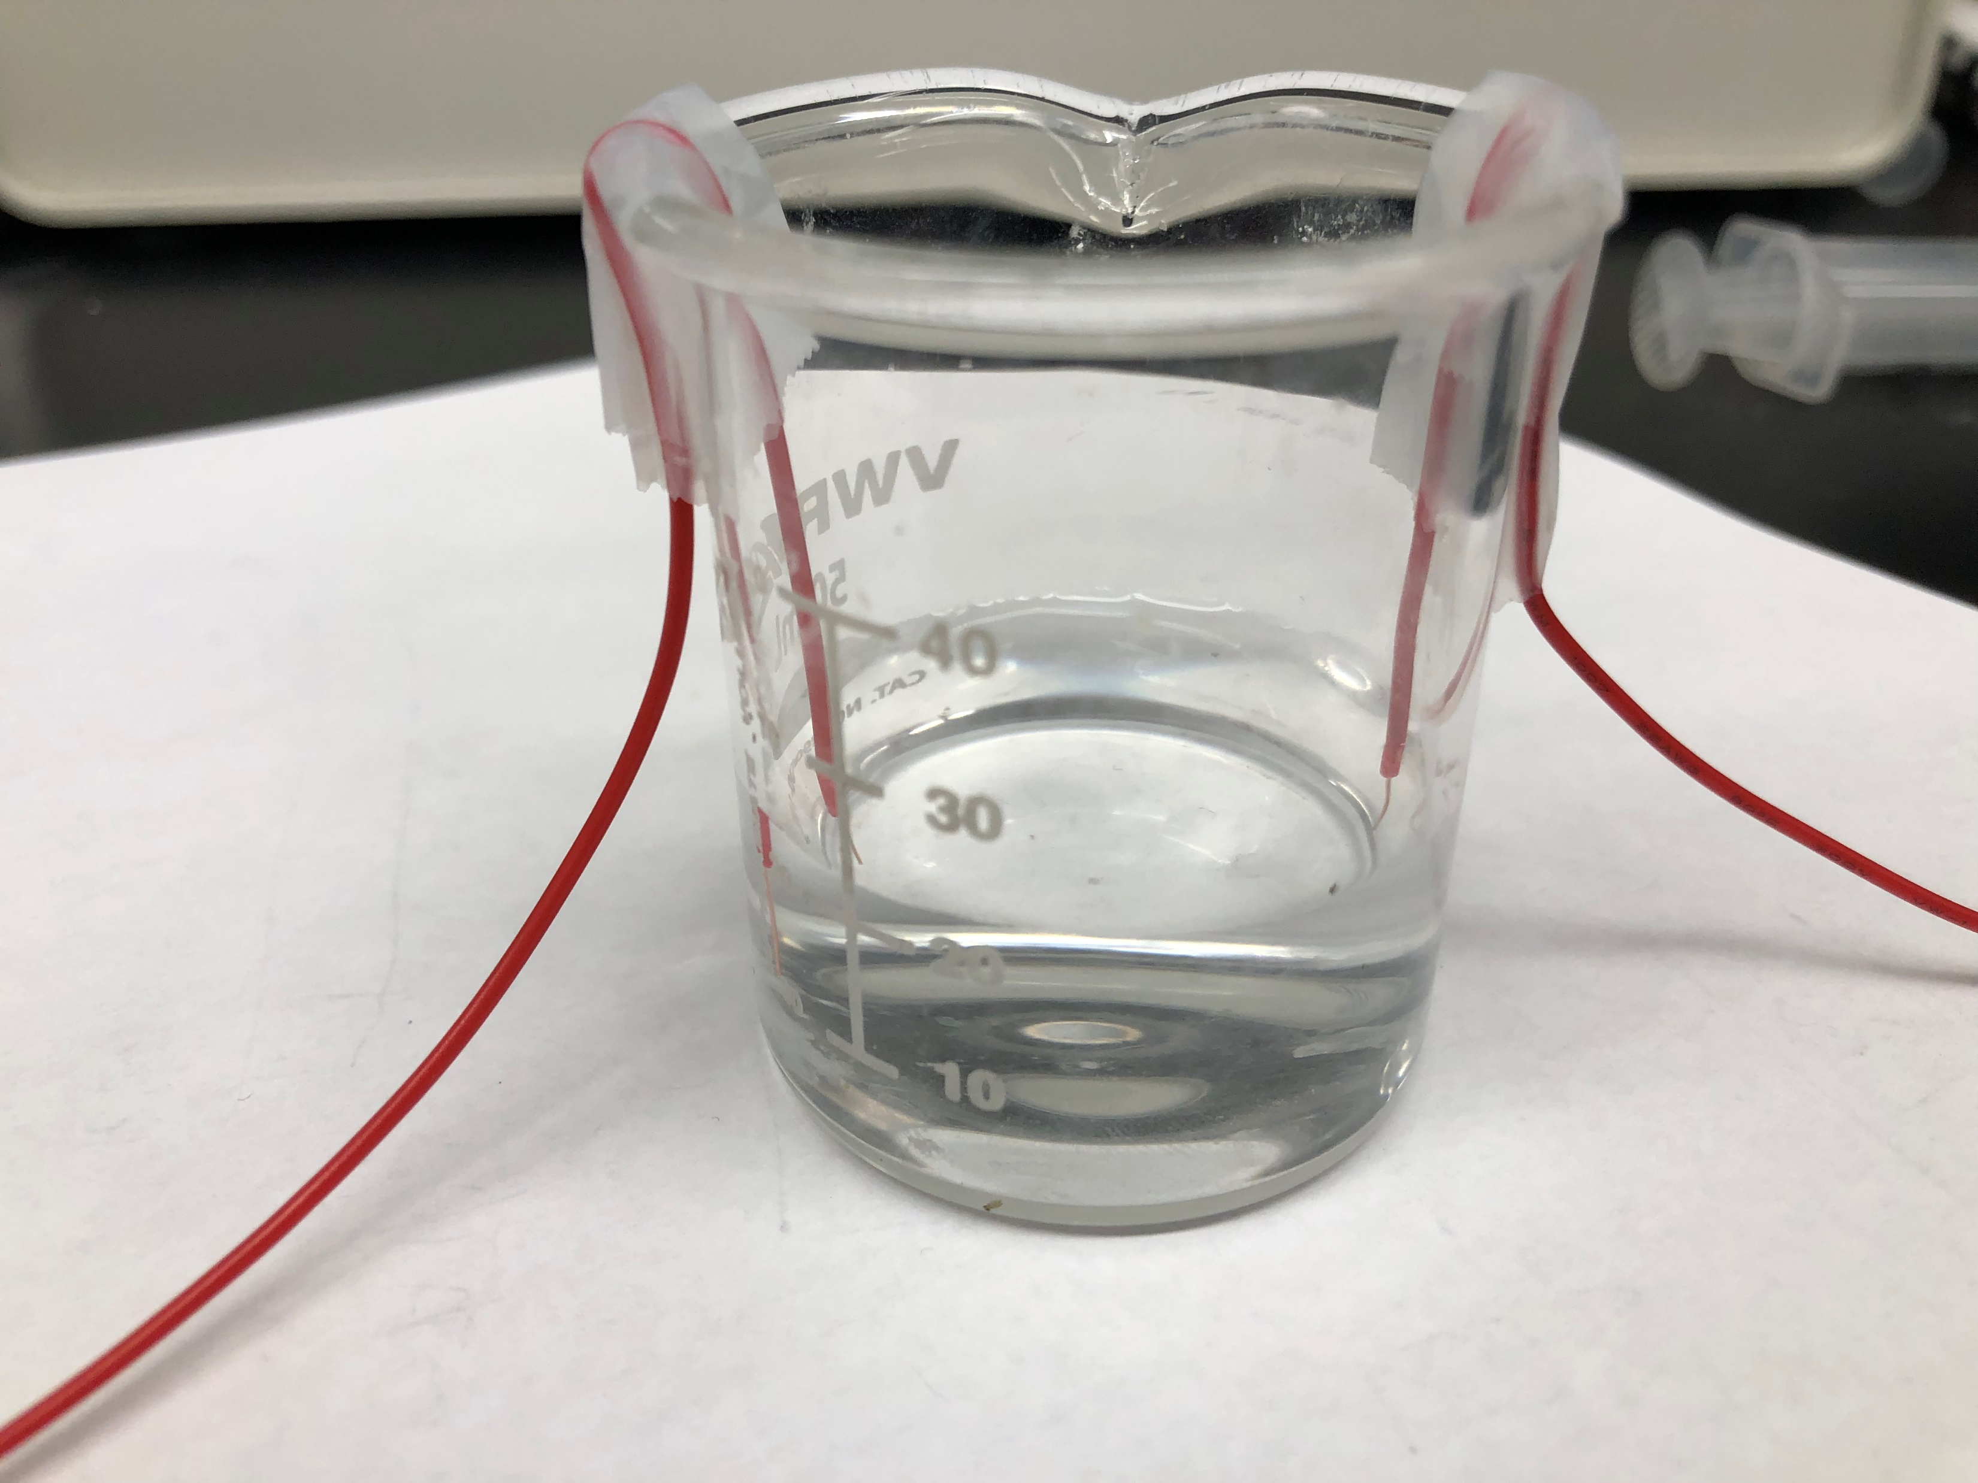
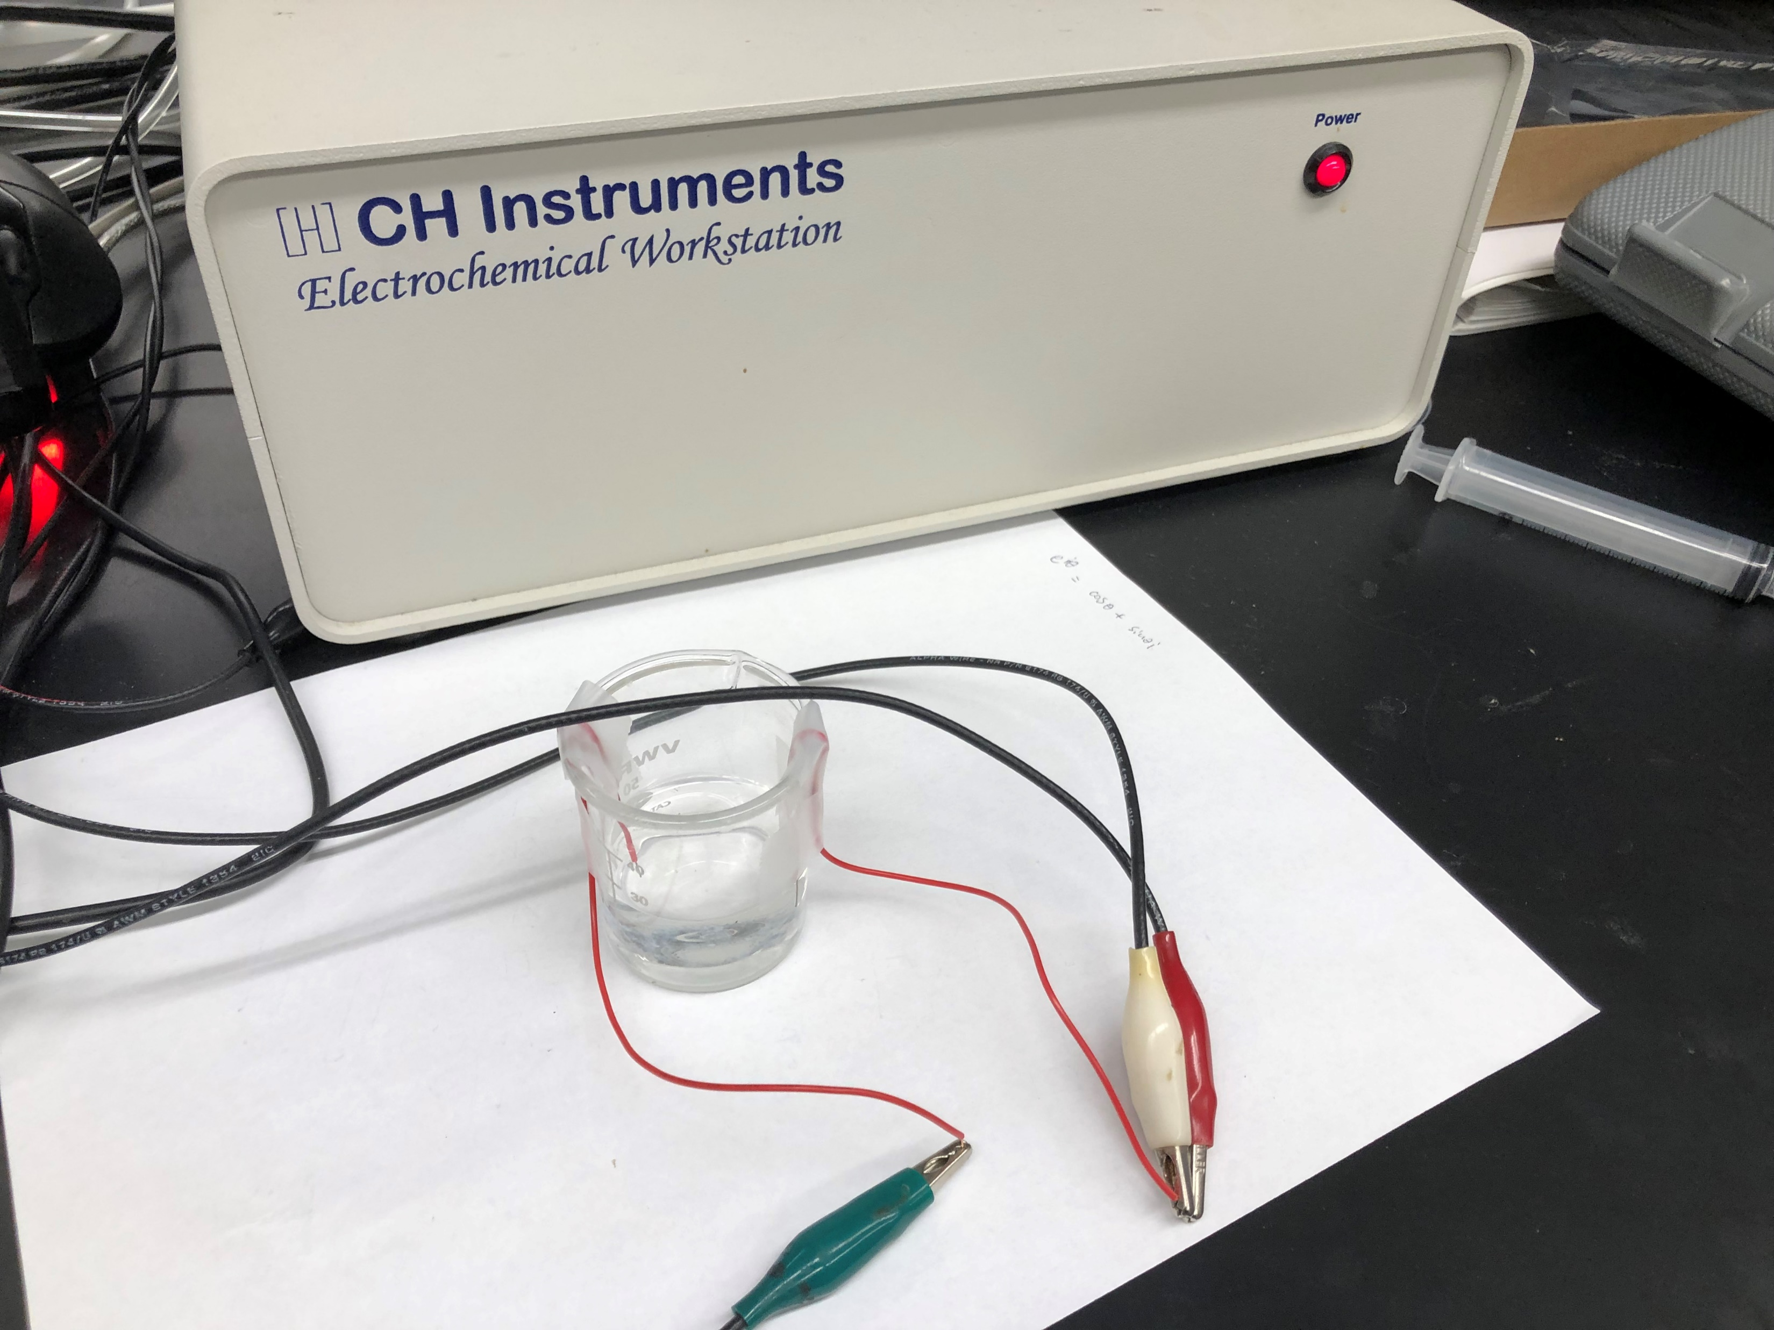
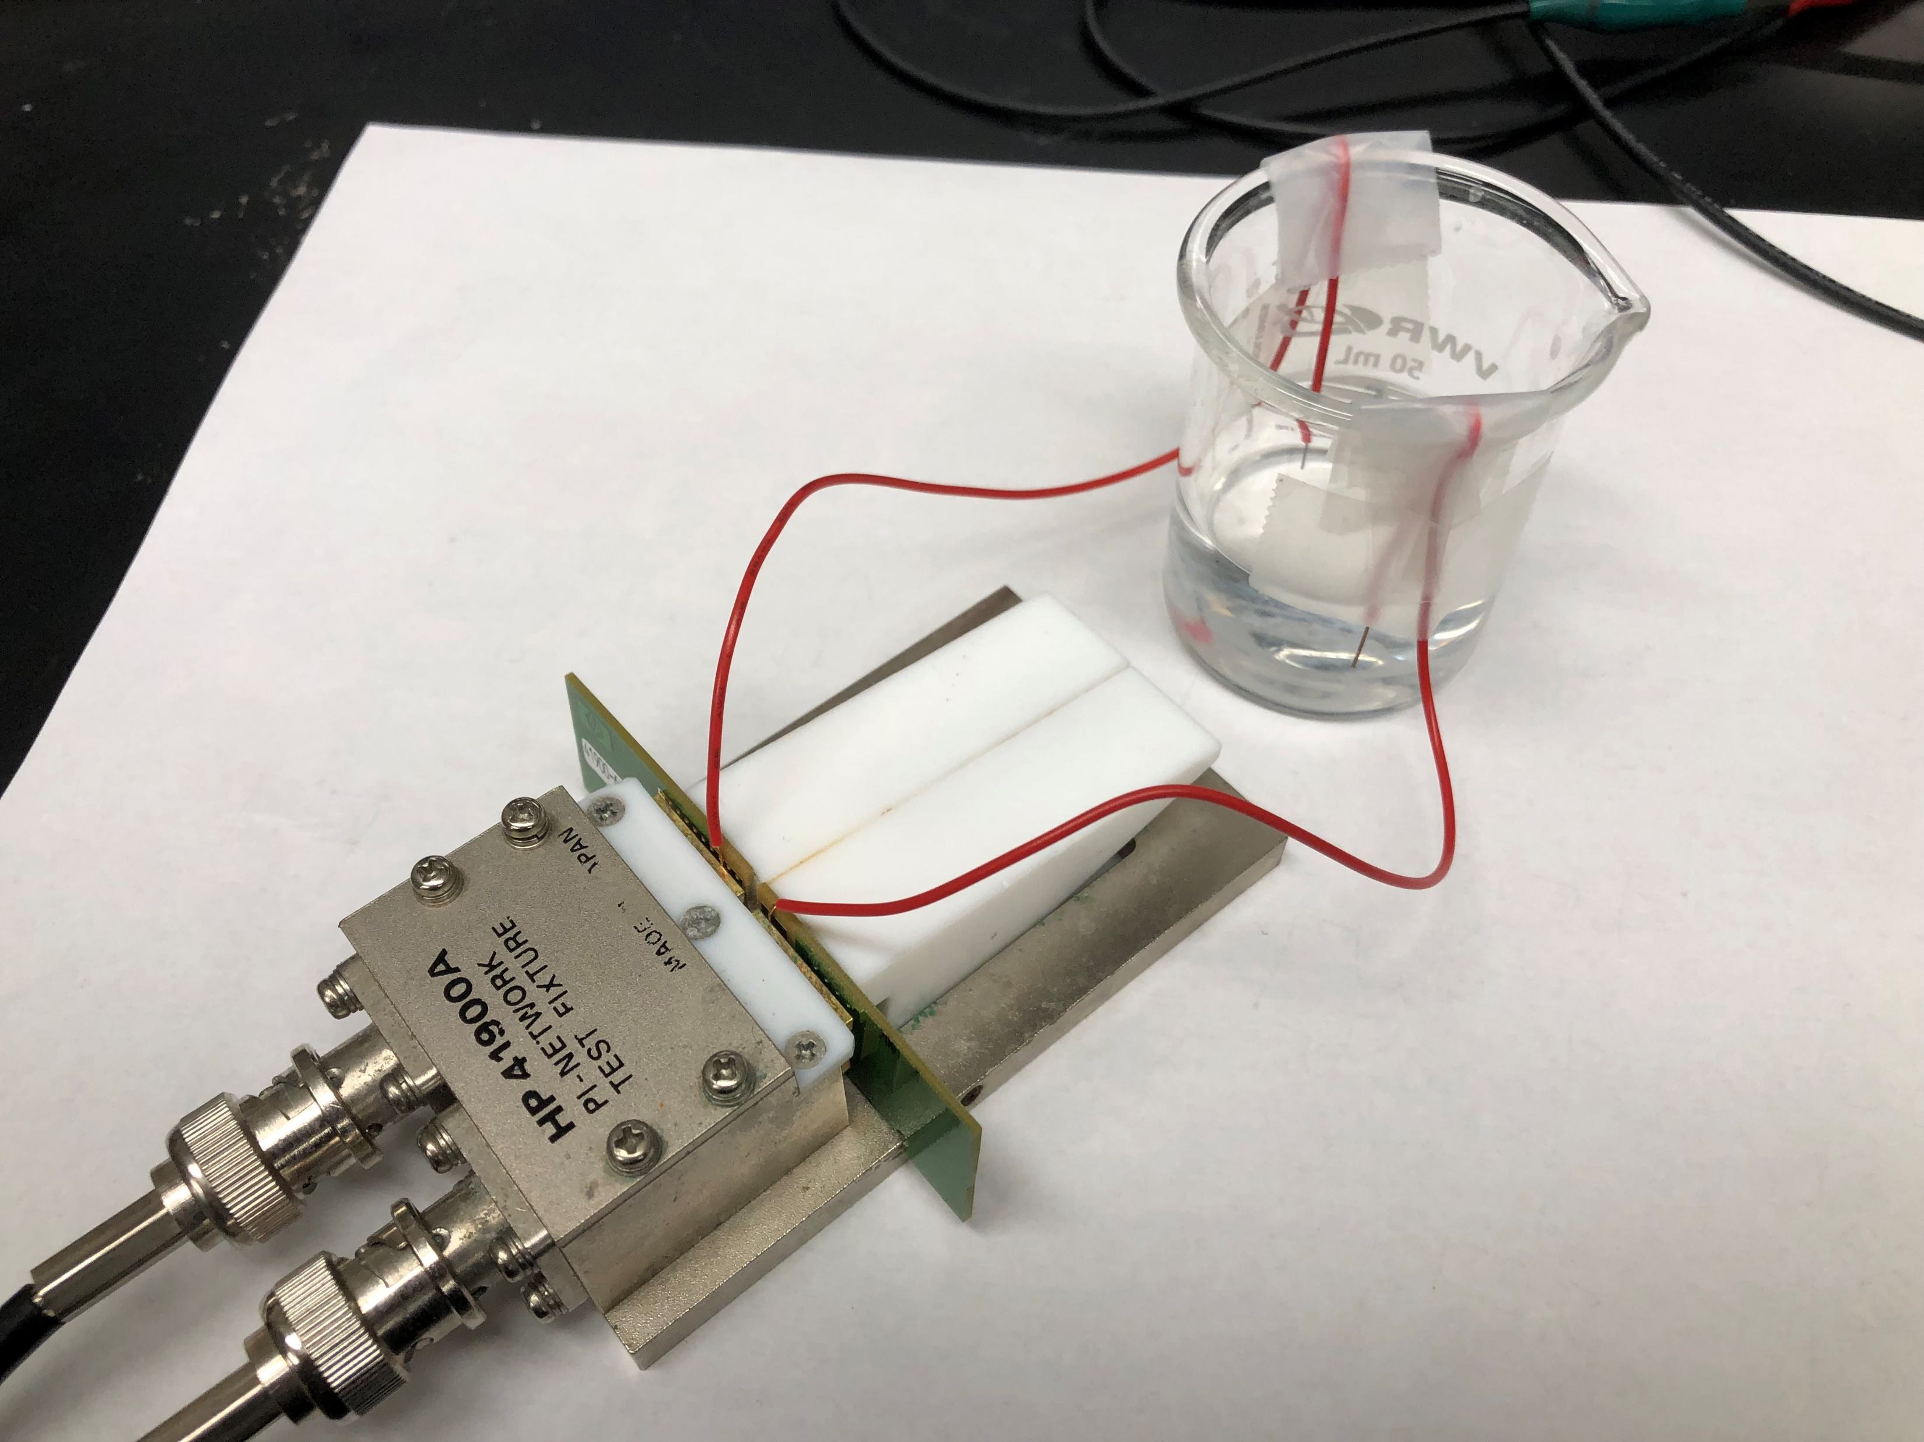
To verify the VNA works
Compare the result of EIS and VNA devices
EIS and VNA are both used to measure the impedance
spectroscopy of a PBS solution
Since the movement of the probe can have a big influence on the result, the wires are fixed using tapes

Slide 9
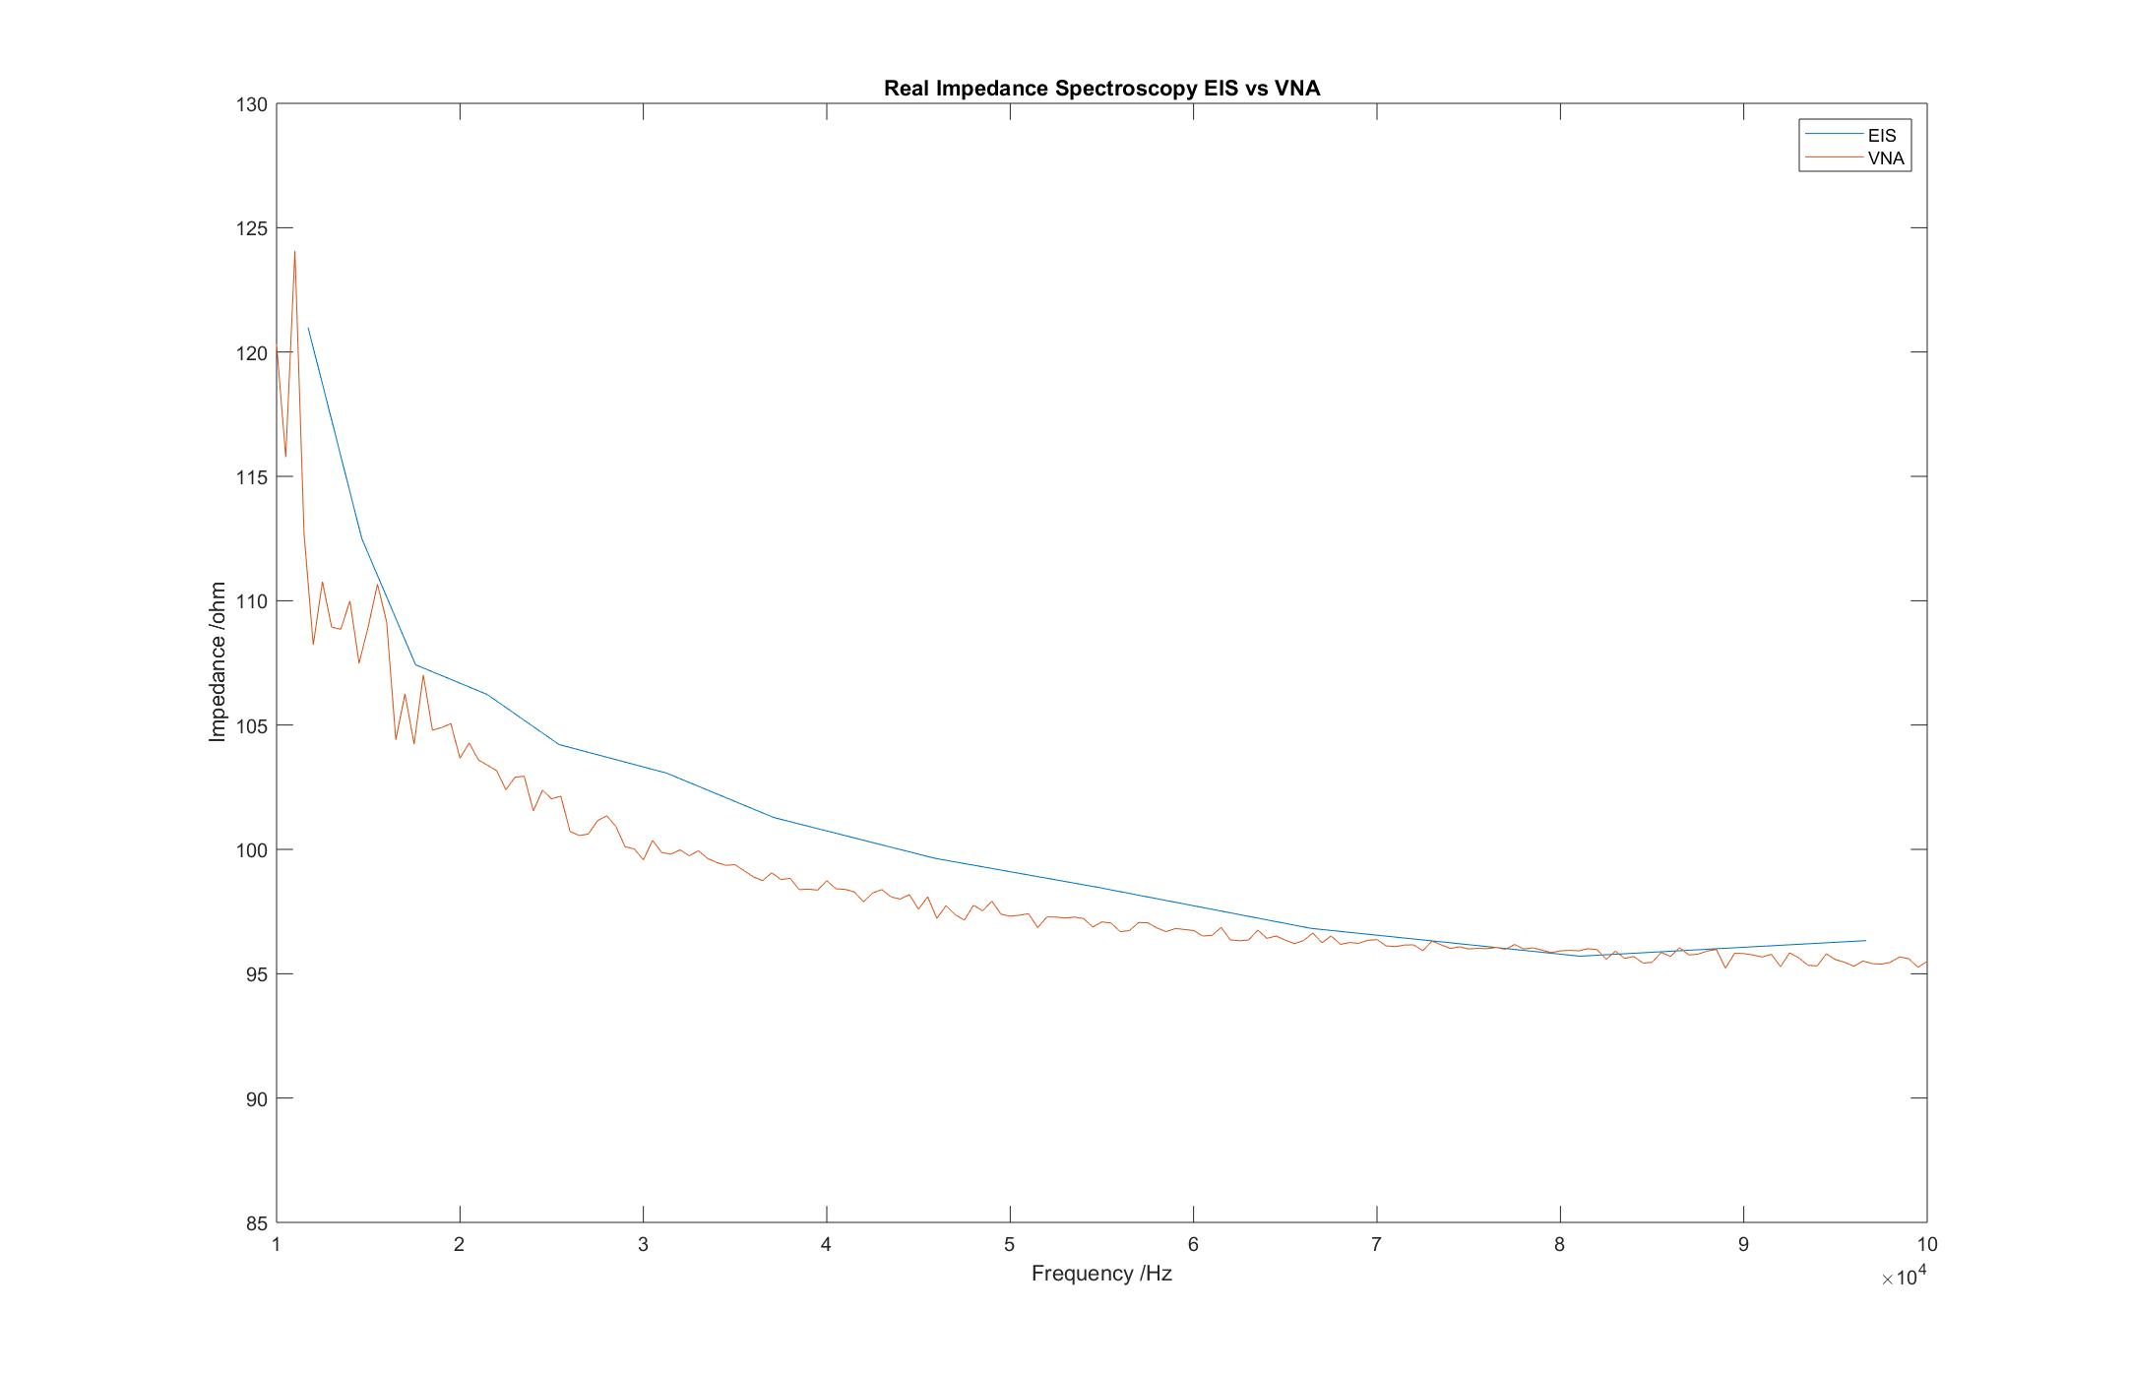
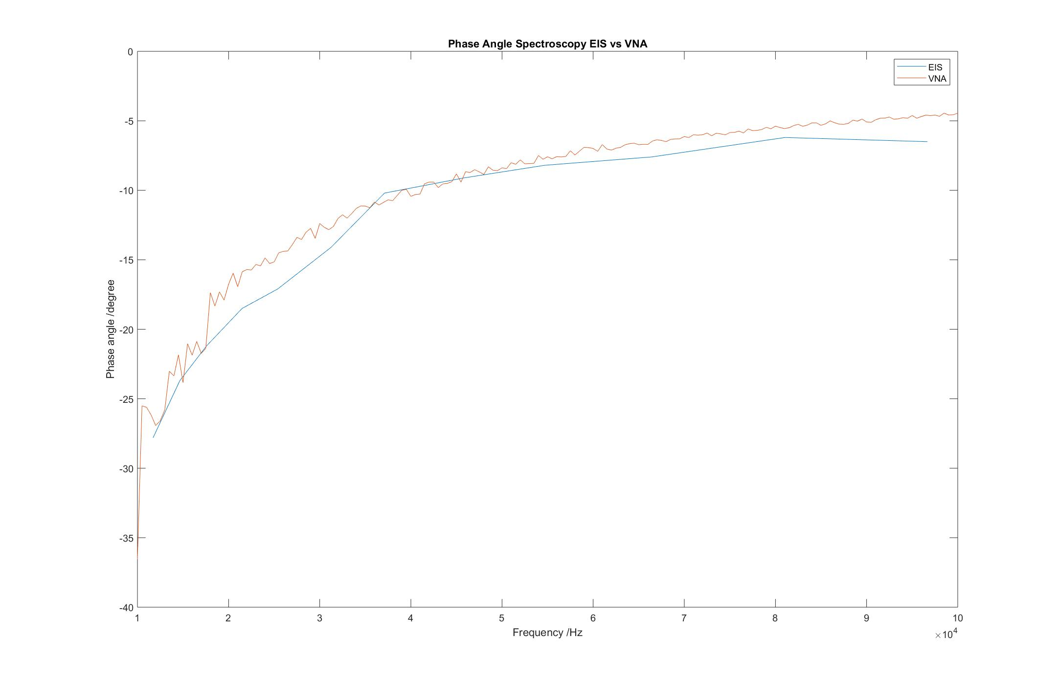
To verify the VNA works
The results of 10khz - 100khz

Slide 10
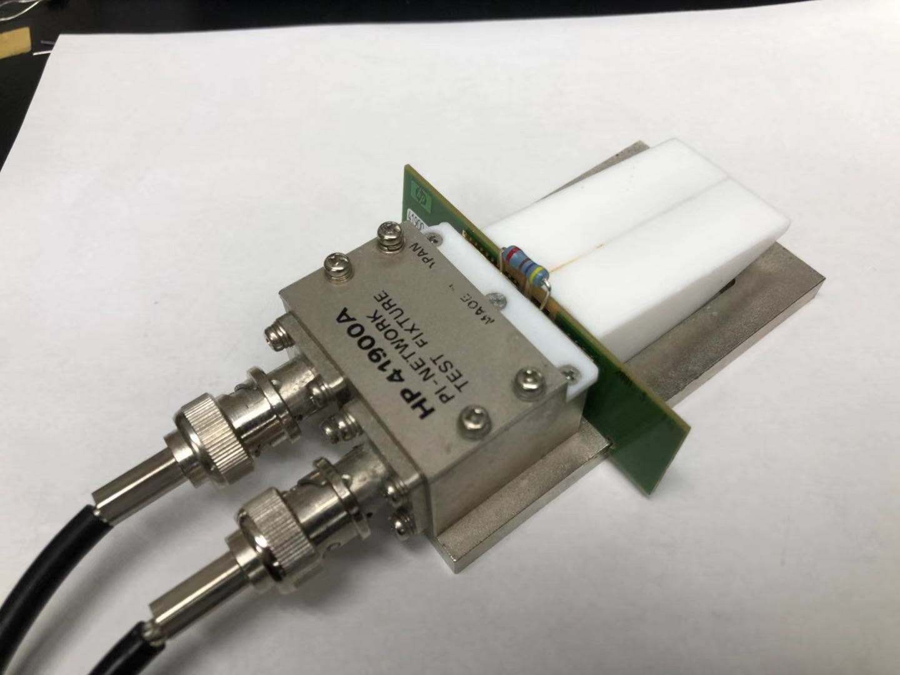
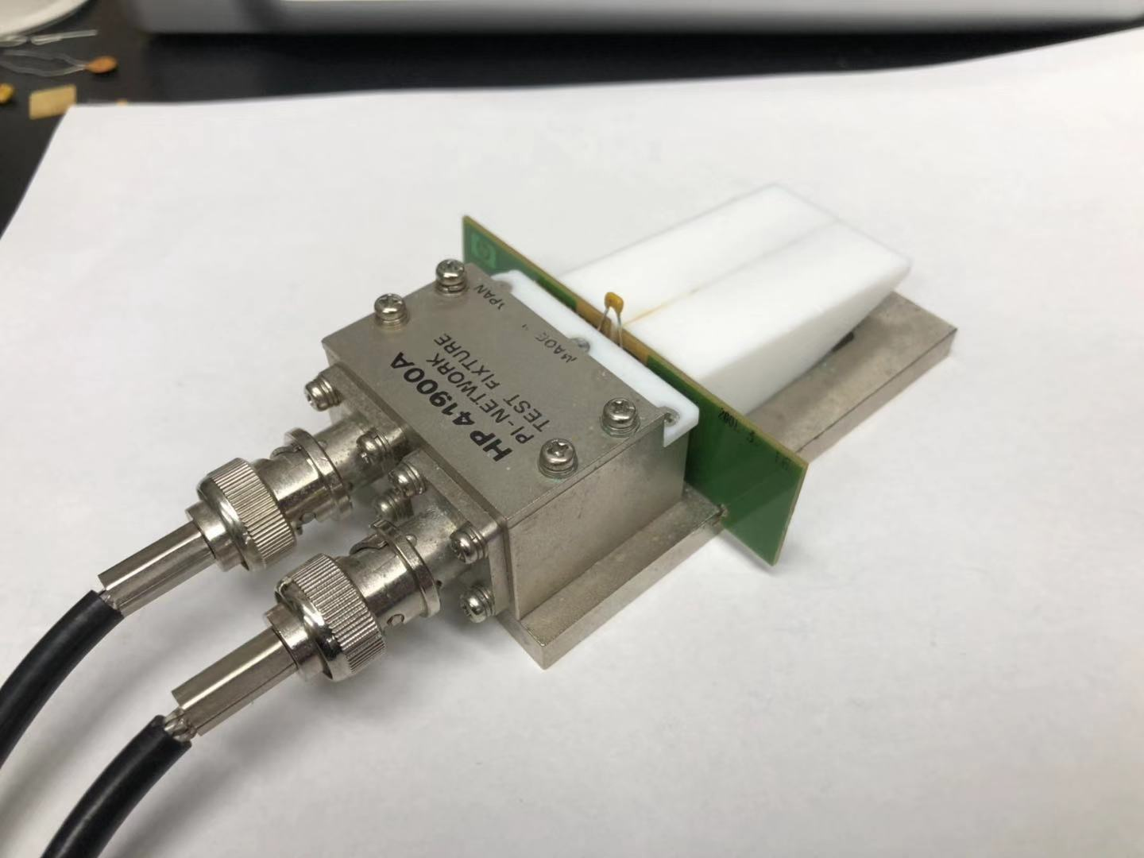
To verify the VNA works
Is the result in higher frequency accurate?
There is no existing research on the impedance spectroscopy of PBS at a very high frequency such as 100Mhz. So we use resistors and capacitors to check the accuracy of the VNA at higher frequency(e.g. 100Mhz)

Slide 11
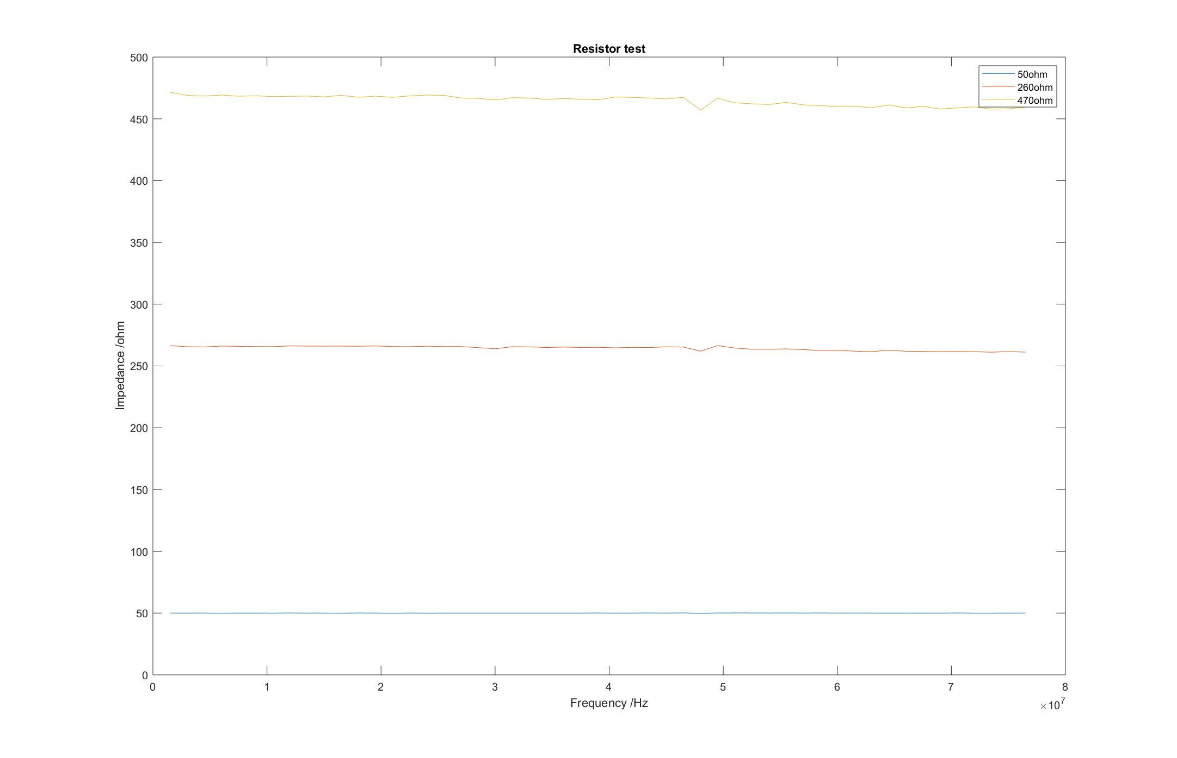
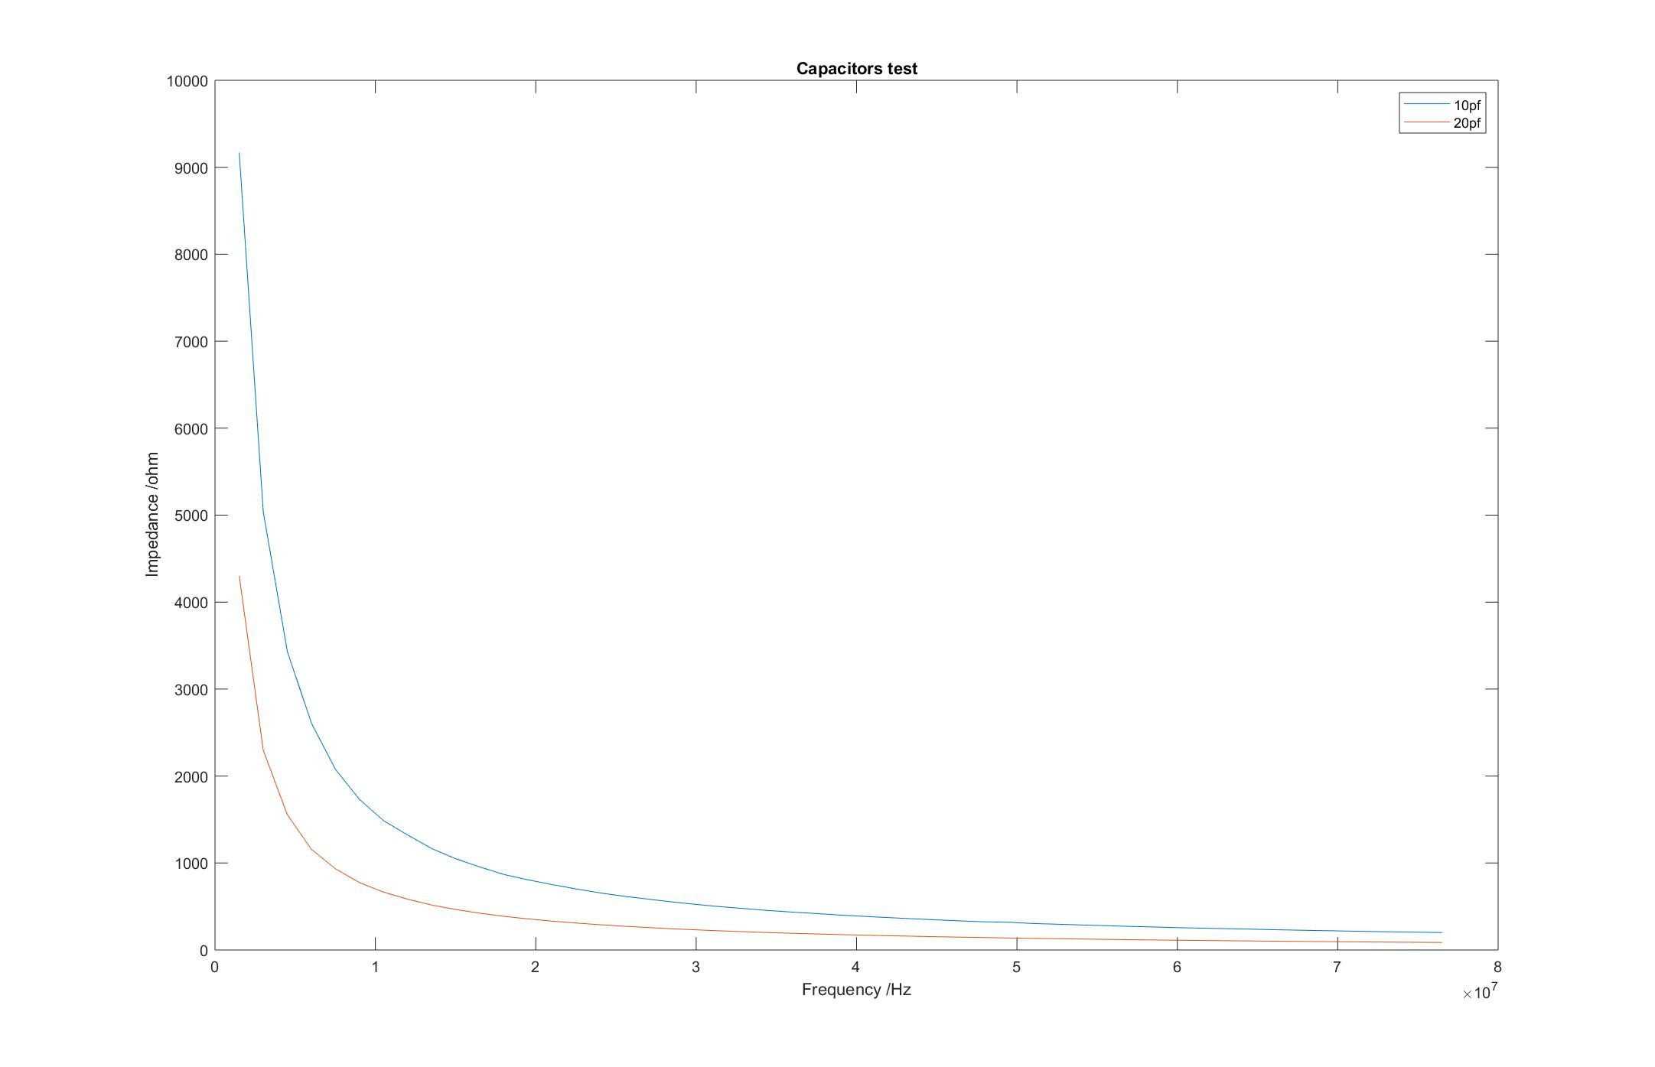
To verify the VNA works
The results of the capacitor and resistor test nicely match the theoretical value

Slide 12
To conclude
There are three evidence supporting that this machine can be used for electrochemical impedance spectroscopy measurements.
The mechanism of the VNA shows no theoretical deficiency on electrochemical spectroscopy measurements
The result of VNA and EIS in a lower frequency matches each other nicely
The results of the resistor and capacitor tests imply this machine has high accuracy at a higher frequency.

Slide 13
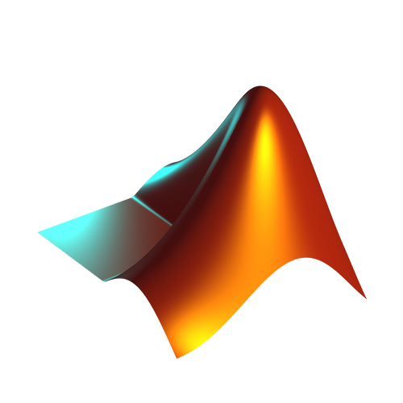

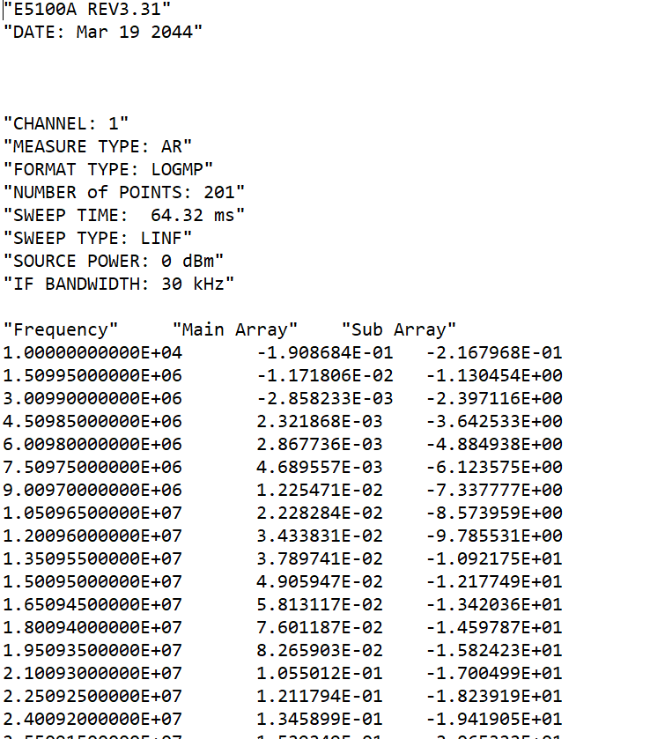
Communication using GPIB interface
The communication between VNA and computer utilize a GPIB-USB cable
We can find the commands for VNA in the Agilent E5100A programme manual. Commands are sent using the NI488.2 application programme interface.
MATLAB is finally used for the goods of the communication, data processing and demonstration,
Send commands according to the E5100A programme manual
e.g. ‘OUTPRAW?’ ‘OUTPDATA?’
Send commands to network analyser according to NI488.2 API
Process the data and plot it
Return the data

Slide 14
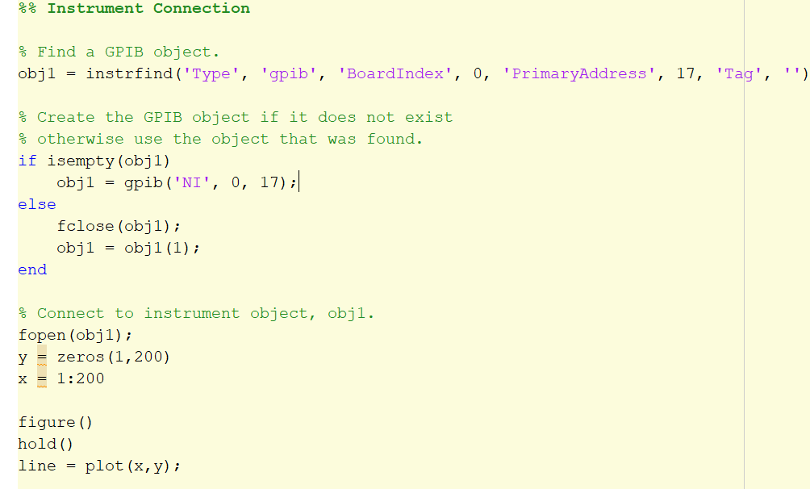
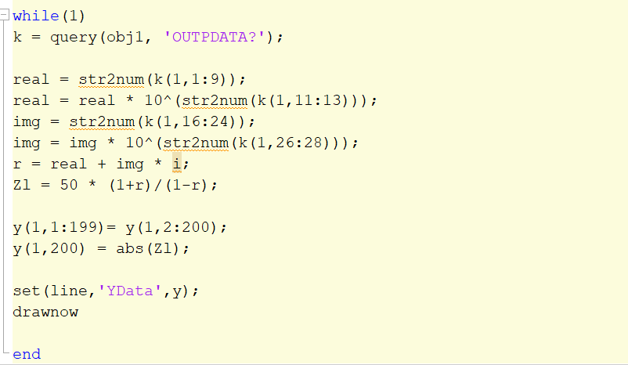
Example

Slide 15
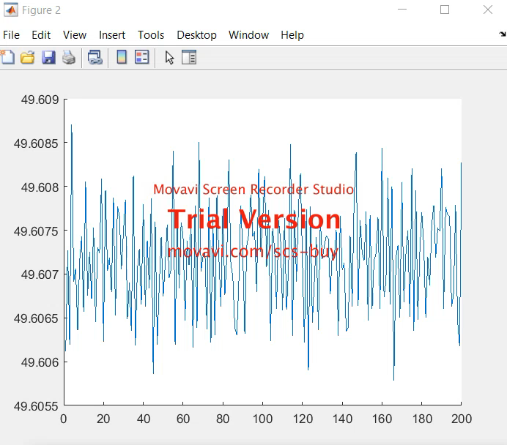
Example
A new data point is measured every 640us
Conclusion
The machine is capable of carrying out real time impedance monitoring and recording using MATLAB

Slide 16
Discussion and future work
The device generally solves our problem but there are a couple of things can be done in the future
Using two wires and using tapes to fix the wire could be quite “primitive”, if we could find other probes that fits with the network test fixature, we might get a better result.
I still don’t understand how to do calibrate the devices using the GPIB cable although it is possible according to the programme manual.

